Slide 1
Internet of Things

Slide 2
Course Outcomes
CO1 Explain the impact and challenges posed by IoT networks leading to new architectural Models
CO2 Compare and contrast the deployment of smart objects and the technologies to connect them to network.
CO3 Explain the role of IoT protocols for efficient network communication.
CO4 Illustrate different sensor technologies for sensing real world entities and identify the applications of IoT in Industry.

Slide 3
Syllabus
Course Title: Internet of Things | Course Code: 22CS630
Credits: 4 | Contact Hours (L: T: P): 39:0:26
Type of Course: Theory with Integrated Lab | Category: Professional Core Course
CIE Marks: 50 | SEE Marks: 100

Slide 4
Syllabus – Course Objectives
Sl. No. | Course Objectives
1 | Assess the genesis and impact of IoT applications, architectures in real world.
2 | Illustrate diverse methods of deploying smart objects and connect them to network.
3 | Compare different Application protocols for IoT.
4 | Identify sensor technologies for sensing real world entities and understand the role of IoT in various domains of Industry.

Slide 5
Syllabus – Unit 1
Unit No. | Course Content | No. of Hours
1 | Introduction: What is IoT, Genesis of IoT, IoT and Digitization, IoT Impact, Convergence of IT and IoT, IoT Challenges, IoT Network Architecture and Design, Drivers Behind New Network Architectures, Comparing IoT Architectures, A Simplified IoT Architecture, The Core IoT Functional Stack, IoT Data Management and Compute Stack. | 8

Slide 6
Syllabus – Unit 2
Unit No. | Course Content | No. of Hours
2 | Smart Objects: The ―Things‖ in IoT, Sensors, Actuators, and Smart Objects, Sensor Networks, Connecting Smart Objects, Communications Criteria, IoT Access Technologies (IEEE 802.15.4). | 8

Slide 7
Syllabus – Unit 3
Unit No. | Course Content | No. of Hours
3 | IP as the IoT Network Layer: The Business Case for IP, the need for Optimization, Optimizing IP for IoT, Application Protocols for IoT, The Transport Layer Protocols for IoT. | 8

Slide 8
Syllabus – Unit 4
Unit No. | Course Content | No. of Hours
4 | Data and Analytics for IoT: An Introduction to Data Analytics for IoT, Machine Learning, Big Data Analytics Tools and Technology, Edge Streaming Analytics, Network Analytics. Securing IoT: A Brief History of OT Security, Common Challenges in OT Security, How IT and OT Security Practices and Systems Vary, Formal Risk Analysis Structures: OCTAVE and FAIR. | 8

Slide 9
Syllabus – Unit 5
Unit No. | Course Content | No. of Hours
5 | IoT Physical Devices and Endpoints: Arduino UNO: Introduction to Arduino, Arduino UNO, Installing the Software, Fundamentals of Arduino Programming. IoT Physical Devices and Endpoints - RaspberryPi: Introduction to RaspberryPi, Programming RaspberryPi with Python, Smart and Connected Cities: An IoT Strategy for Smarter Cities, Smart City IoT Architecture, Smart City Security Architecture, Smart City UseCase Examples. | 7

Slide 10
Syllabus – Textbook
Sl. No. | Author/s | Title | Publisher Details
1 | David Hanes, Gonzalo Salgueiro, Patrick Grossetete, Robert Barton, Jerome Henry | IoT Fundamentals: Networking Technologies, Protocols, and Use Cases for the Internet of Things | 1st Edition, Pearson Education (Cisco Press Indian Reprint). (ISBN:978- 9386873743),2017
2 | Srinivasa K G | Internet of Things | CENGAGE Leaning India, 2018.

Slide 11
Syllabus – References
Sl. No. | Author/s | Title | Publisher Details
1 | Vijay Madisetti and Arshdeep Bahga | Internet of Things (A Hands-on-Approach) | 1st Edition, VPT, 2014. (ISBN:978-8173719547)
2 | Raj Kamal | Internet of Things: Architecture and Design Principles | 1st Edition, McGraw Hill Education, 2017.
3 | Cuno Pfister | Getting Started with the Internet of Things | O’Reilly Media, 2011, ISBN: 978-1-4493- 9357-1.
4 | Jan Holler, Vlasios Tsiatsis, Catherine Mulligan, Stefan Avesand, Stamatis Karnouskos, David Boyle | From Machine-toMachine to the Internet of Things: Introduction to a New Age of Intelligence | 1st Edition, Academic Press, 2014

Slide 12
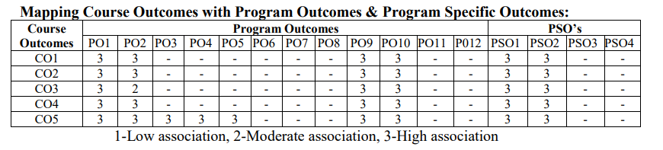
Syllabus – Web link
Sl. No. | Web Link
1 | https://nptel.ac.in/courses/106/105/106105195/
2 | https://nptel.ac.in/courses/106/105/106105166/

Slide 13
Unit 1 Introduction

Slide 14
What is IoT
The Internet of Things (IoT) is a network of devices that can communicate with each other and the internet.
These devices can include everyday objects like toothbrushes and cars, as well as industrial tools.
The Internet of Things (IoT) is a rapidly growing technological concept that connects everyday physical objects to the internet, allowing them to collect, exchange, and act on data.
These "things" include devices such as smart home appliances, wearable health trackers, industrial machines, vehicles, and more — all equipped with sensors, software, and network connectivity.

Slide 15
What is IoT
The core idea of IoT is to enable seamless communication between devices without human intervention.
For example, a smart thermostat can adjust the room temperature based on user preferences and weather forecasts, while a fitness band can monitor physical activity and send health data to a smartphone or cloud server.
IoT plays a significant role in various domains, including smart homes, healthcare, agriculture, transportation, manufacturing, and smart cities. It helps improve efficiency, reduce human effort, and generate valuable insights through data analysis.

Slide 16

Genesis of IoT
The term "Internet of Things" was first coined by Kevin Ashton in 1999 while working at Procter & Gamble.
He used it to describe a system where the internet is connected to the physical world through sensors.

Slide 17
Genesis of IoT
The genesis of the Internet of Things (IoT) can be traced back to the convergence of multiple technologies, including embedded systems, wireless communication, and the internet.
The idea of connecting machines and devices for communication dates back to the early days of computing and networking.

Slide 18
Genesis of IoT
Ashton envisioned a world where physical objects could automatically collect and share data without human involvement.
However, even before the term was coined, early developments laid the groundwork for IoT.
In the 1980s, a group of computer scientists at Carnegie Mellon University connected a Coca-Cola vending machine to the internet to monitor its inventory and temperature.
This is considered one of the first IoT-like applications.

Slide 19
Genesis of IoT
The growth of RFID (Radio Frequency Identification) technology in the 1990s enabled objects to be uniquely identified and tracked.
With the expansion of Wi-Fi, Bluetooth, and the IPv6 protocol, it became possible for billions of devices to be uniquely connected.

Slide 20
IoT and Digitization
IoT
IoT focuses on connecting “things” such as objects and machines, to a computer networks
Digitization
It can be different things to different people but generally encompasses the connection of things with the data they generate and the business insights that result.

Slide 21
IoT and Digitization
Feature | IoT | Digitization
Purpose | Data sharing & automation | Data conversion
Tools | Sensors, devices, cloud | Scanners, computers
Example | Smart fridge(cooling) | Scanned document
Use Case | Smart homes | e-Government records

Slide 22
IoT Impact
The IoT is changing how we live, work, and interact with the world by connecting devices to the internet and enabling real-time data sharing, control, and automation.
Smart Homes
Devices like smart lights, thermostats, and security systems make life easier and safer.
Example: You can turn off your lights or lock doors using your phone from anywhere.

Slide 23
IoT Impact
2. Smart Businesses & Industries
IoT improves efficiency, safety, and productivity.
Machines can self-monitor, detect issues early, and reduce downtime.
Used in factories, agriculture, logistics, and energy management.
3. Healthcare
Wearable devices monitor heart rate, steps, and sleep.
Remote patient monitoring helps doctors track health without hospital visits.
Enables faster diagnosis and better treatment.

Slide 24
IoT Impact
4. Smart Cities
IoT helps manage traffic, waste, water, and electricity efficiently.
Smart traffic lights reduce jams and improve emergency response.
Helps in building cleaner and more sustainable cities.
5. Transportation
Connected vehicles improve road safety and fuel efficiency.
GPS and IoT help track public transport in real-time.

Slide 25
IoT Impact
6. Agriculture
Smart sensors monitor soil moisture, temperature, and crop health.
Farmers can make better decisions and increase yield with less effort.
7. Data-Driven Decisions
Devices collect huge amounts of data.
Businesses and governments use this data to make smart, fast, and accurate decisions.

Slide 26
Convergence of IT and OT
Criteria | Industrial OT Network | Enterprise IT Network
Operational focus | Keep the business operating 24x7 | Manage the companies, data and employee communicate system in a secure way
Priorities | Availability Integrity Security | Security Integrity Availability
Types of Data | Monitoring, control and supervisory data | Vois, video, transactional and bulk data
Security | Controlled physical access to devices | Devices and users authentical to the network
Implication of failure | OT network disruption directly impacts business | Can be business impacting, depending on industry but workarounds may be possible

Slide 27
Convergence of IT and OT
Criteria | Industrial OT Network | Enterprise IT Network
Network upgrades | Only during operational maintenance windows | Often requires an outage window when workers are not onsite; impact can be mitigated
Security vulnerability | Low; OT networks are isolated and often use proprietary protocols | High; continual patching of hosts a required, and the network is connected to Internet and requires vigilant protection

Slide 28
IoT Challenges
 | Issue | Challenge | Example
Security & Privacy | IoT devices collect personal data (location, health, usage patterns). | If not protected, hackers can steal or misuse the data. | A smart home camera being hacked.
Connectivity & Network Issues | IoT needs continuous internet or network. | Poor connectivity can cause device failure or data loss. | A smart door lock not working during network outage.
Power Management | Many IoT devices are battery-powered. | Frequent charging or replacement affects usability. | Sensor in a farm running out of battery mid-season.
Device Compatibility | Different manufacturers, different standards. | Devices may not “talk” to each other. | A smart fridge can't connect to a smart home app.

Slide 29
IoT Challenges
 | Issue | Challenge | Example
Data Overload | Billions of devices = Massive data. | Storing, processing, and analyzing this much data is hard. | A smart city with thousands of sensors flooding the system.
High Initial Cost | Setting up IoT infrastructure is expensive.. | Especially difficult for small businesses or rural areas. | Installing smart farming systems on a budget.
Maintenance & Updates | Devices need regular software updates. | Users may ignore updates, leading to bugs or security issues. | A wearable fitness band not syncing after a missed update.

Slide 30



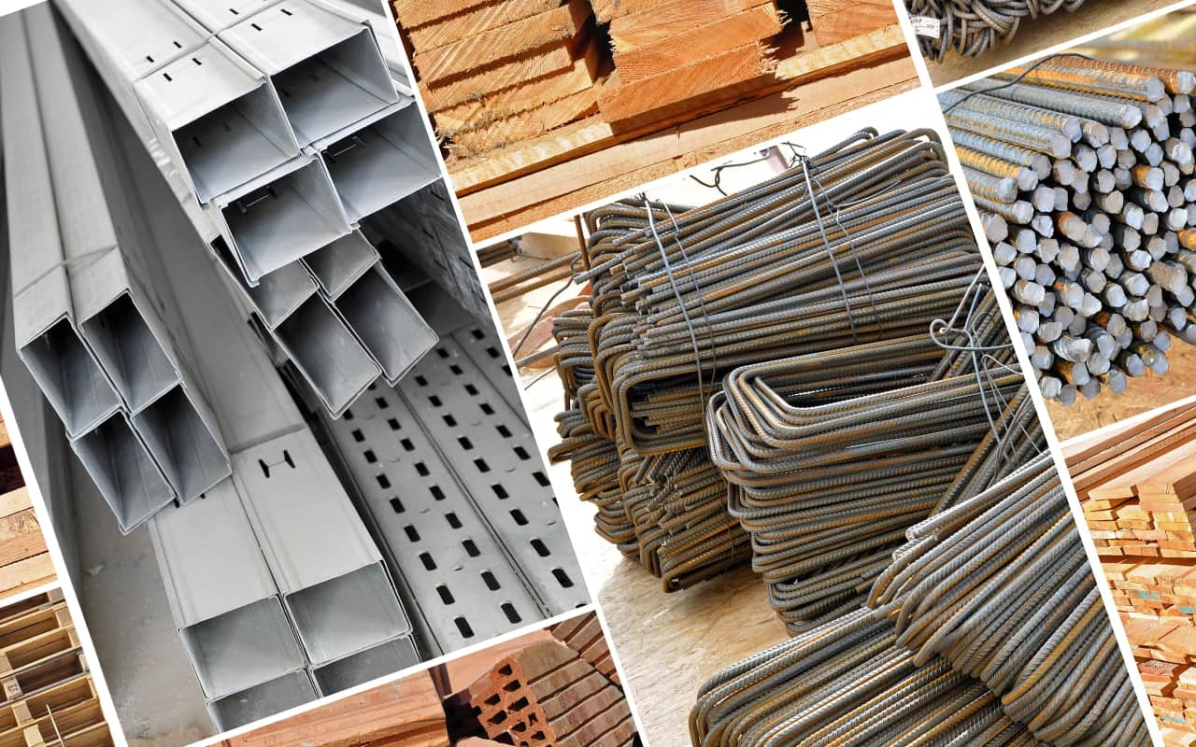
IoT Network Architecture and Design
Decided to build a new home

Slide 31
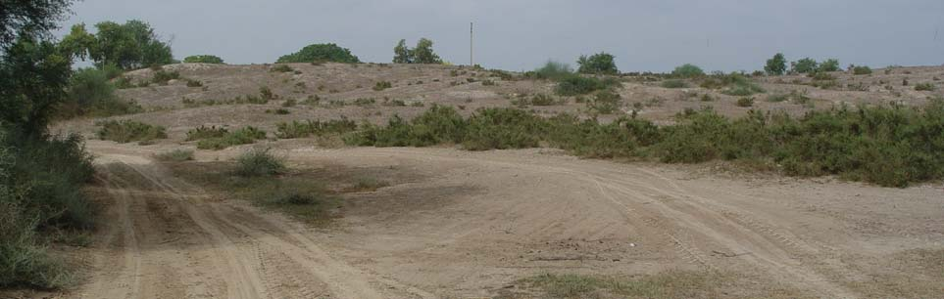
IoT Network Architecture and Design
Where should we start from

Slide 32



IoT Network Architecture and Design

Slide 33
Drivers Behind New Network Architectures
Challenge | Description | IoT Architectural Change Required
Scale | The massive scale of IoT end points (sensors) is far beyond that of typical IT networks | The IPv4 address space has reached exhaustion and is unable to meet IoT’s scalability requirements. Scale can be met only by using IPv6. IT networks continue to use IPv4 through features like Network Address Translation (NAT).
Security | IoT devices, especially those on wireless sensor networks (WSNs), are often physically exposed to the world. | Security is required at every level of the IoT network. Every IoT endpoint node on the network must be part of the overall security strategy and must support device-level authentication and link encryption. It must also be easy to deploy with some type of a zero-touch deployment model.

Slide 34
Drivers Behind New Network Architectures
Challenge | Description | IoT Architectural Change Required
Devices and networks constrained by power, CPU, memory, and link speed | Due to the massive scale and longer distances, the networks are often constrained, lossy, and capable of supporting only minimal data rates (tens of bps to hundreds of Kbps). | New last-mile wireless technologies are needed to support constrained IoT devices over long distances. The network is also constrained, meaning modifications need to be made to traditional network-layer transport mechanisms.
The massive volume of data generated | The sensors generate a massive amount of data on a daily basis, causing network bottlenecks and slow analytics in the cloud. | Data analytics capabilities need to be distributed throughout the IoT network, from the edge to the cloud. In traditional IT networks, analytics and applications typically run only in the cloud.

Slide 35
Drivers Behind New Network Architectures
Challenge | Description | IoT Architectural Change Required
Support for legacy devices | An IoT network often comprises a collection of modern, IP-capable endpoints as well as legacy, non-IP devices that rely on serial or proprietary protocols. | Digital transformation is a long process that may take many years, and IoT net works need to support protocol translation and/or tunneling mechanisms to support legacy protocols over standard based protocols, such as Ethernet and IP.
The need for data to be analyzed in real time | Whereas traditional IT networks perform scheduled batch processing of data, IoT data needs to be analyzed and responded to in real-time. | Analytics software needs to be positioned closer to the edge and should support real-time streaming analytics. Traditional IT analytics software (such as relational databases or even Hadoop), are better suited to batch-level analytics that occur after the fact.

Slide 36
Drivers Behind New Network Architectures
Scale
Security
Constrained Devices and Networks
Data
Legacy Device Support

Slide 37
Drivers Behind New Network Architectures
Scale
The scale of a typical IT network is on the order of several thousand devices—typically printers, mobile wireless devices, laptops, servers, and so on.
The traditional three-layer campus networking model, supporting access, distribution, and core (with subarchi tectures for WAN, Wi-Fi, data center, etc.),

Slide 38
Drivers Behind New Network Architectures
Scale
But when a scale of a network goes from a few thousand endpoints to a few millions the IT engineers lack a required skills to design a network that is intended to support millions of routable IP endpoints.

Slide 39
Drivers Behind New Network Architectures
Security
The frequency and impact of cyber attacks in recent years has increased dramatically. Protecting corporate data from intrusion and theft is one of the main functions of the IT department.
IoT systems require consistent mechanisms of authentication, encryption, and intrusion prevention techniques that understand the behavior of industrial protocols and can respond to attacks on critical infrastructure

Slide 40
Drivers Behind New Network Architectures
Security
For optimum security,
IoT systems must: Be able to identify and authenticate all entities involved in the IoT service(i.e., gateways, endpoint devices, home networks, roaming networks, service platforms)
Ensure that all user data shared between the endpoint device and back-end applications is encrypted

Slide 41
Drivers Behind New Network Architectures
Constrained Devices and Networks
Most IoT sensors are designed for a single job, and they are typically small and inexpensive. This means they often have limited power, CPU, and memory, and they transmit only when there is something important.
If an IT network has performance constraints, the solution is simple: Upgrade to a faster network.
If too many devices are on one VLAN and are impacting performance, we can simply carve out a new VLAN and continue to scale as much as we need.

Slide 42
Drivers Behind New Network Architectures
Data
IoT devices generate a mountain of data. In general, most IT shops don’t really care much about the unstructured chatty data generated by devices on the network.
However, in IoT the data is like gold, as it is what enables businesses to deliver new IoT services that enhance the customer experience, reduce cost, and deliver new revenue opportunities

Slide 43
Drivers Behind New Network Architectures
Data
Although most IoT-generated data is unstructured, the insights it provides through analytics can revolutionize processes and create new business models.
For ex : Imagine a smart city with a few hundred thousand smart streetlights, all connected through an IoT network.
However, when all this data is combined, it can become difficult to manage and analyze effectively.

Slide 44
Drivers Behind New Network Architectures
Legacy Device Support
Supporting legacy devices in an IT organization is not usually a big problem. If someone’s computer or operating system is outdated, she simply upgrades. If someone is using a mobile device with an outdated Wi-Fi standard, such as 802.11b or 802.11g, we can simply deny him access to the wireless network, and he will be forced to upgrade.
In OT systems, end devices are likely to be on the network for a very long time—sometimes decades.

Slide 45
Drivers Behind New Network Architectures
Legacy Device Support
As IoT networks are deployed, they need to support the older devices already present on the network, as well as devices with new capabilities.
In many cases, legacy devices are so old that they don’t even support IP.

Slide 46
Drivers Behind New Network Architectures
Legacy Device Support
For ex :
A factory may replace machines only once every 20 years—or perhaps even longer!
It does not want to upgrade multi-million-dollar machines just so it can connect them to a network for better visibility and control.
However, many of these legacy machines might support older protocols, such as serial interfaces, and use RS-232.
In this case, the IoT network must either be capable of some type of protocol translation or use a gateway device to connect these legacy endpoints to the IoT network

Slide 47
Comparing IoT Architectures
In the past several years, architectural standards and frameworks have emerged to address the challenge of designing massive-scale IoT networks.
The foundational concept in all these architectures is supporting data, process, and the functions that endpoint devices perform.
Two of the best-known architectures
oneM2M
IoT World Forum (IoTWF)

Slide 48
Comparing IoT Architectures
THE ONEM2M IOT STANDARDIZED ARCHITECTURE
European Telecommunications Standards Institute (ETSI) created the M2M Technical Committee in 2008.
The goal of this committee was to
create a common architecture that would help accelerate the adoption of M2M applications and devices.
In 2012 launched oneM2M as a global initiative designed to promote efficient M2M communication systems and IoT.

Slide 49
Comparing IoT Architectures
THE ONEM2M IOT STANDARDIZED ARCHITECTURE
create a common services layer, which can be readily embedded in field devices to allow communication with application servers.
One of the greatest challenges in designing an IoT architecture is dealing with the heterogeneity of devices, software, and access methods.
The oneM2M architecture divides IoT functions into three major domains: the application layer, the services layer, and the network layer.

Slide 50
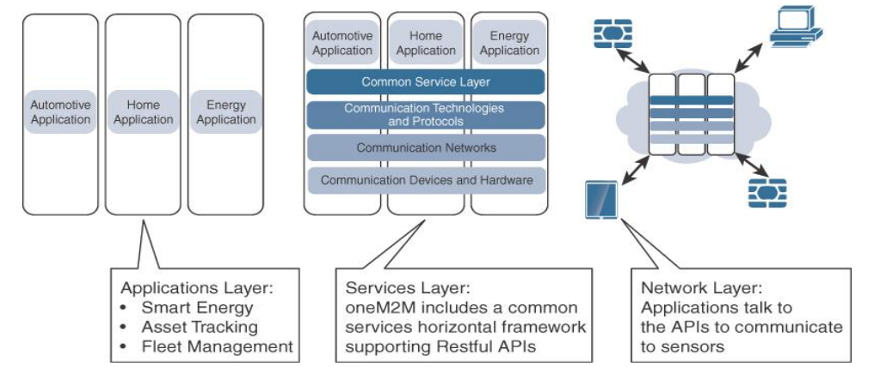
Comparing IoT Architectures
Fig: The Main Elements of the oneM2M IoT Architecture

Slide 51
Comparing IoT Architectures
Application Layer
The oneM2M architecture gives major attention to connectivity between applications, devices and their applications.
This domain includes the application-layer protocols and attempts to standardize API definitions for interaction with business intelligence (BI) systems.

Slide 52
Comparing IoT Architectures
Session Layer
This layer is shown as a horizontal framework across the vertical industry applications.
At this layer, horizontal modules include the physical network that the IoT applications run on, the underlying management protocols, and the hardware.

Slide 53
Comparing IoT Architectures
Network Layer
This is the communication domain for the IoT devices and endpoints.
It includes the devices themselves and the communications network that links them.
The communications infrastructure include wireless mesh technologies, such as IEEE 802.15.4, and wireless point-to-multipoint systems, such as IEEE 801.11
Also included are wired device connections, such as IEEE 1901 power line communications.

Slide 54
Comparing IoT Architectures
THE IOT WORLD FORUM (IOTWF) STANDARDIZED ARCHITECTURE
In 2014 the IoTWF architectural committee (led by Cisco, IBM, Rockwell Automation, and others) published a seven layer IoT architectural reference model.
visualizing IoT from a technical perspective.
Each of the seven layers is broken down into specific functions, and security encompasses the entire model.

Slide 55
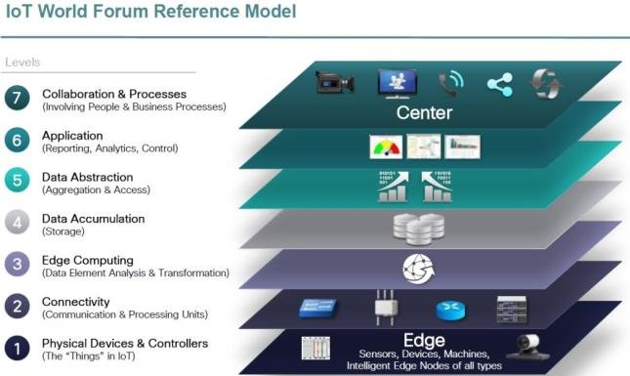
Comparing IoT Architectures
Fig: IoT Reference Model Published by the IoT World Forum

Slide 56
Comparing IoT Architectures
Using this reference model, we are able to achieve the following:
Decompose the IoT problem into smaller parts
Identify different technologies at each layer and how they relate to one another
Define a system in which different parts can be provided by different vendors
Have a process of defining interfaces that leads to interoperability
Define a tiered security model that is enforced at the transition points between levels

Slide 57

Comparing IoT Architectures
1
2
3
4
5
6
7

Slide 58


Slide 59
Comparing IoT Architectures
Layer 1: Physical Devices and Controllers Layer
This layer is home to the “things” in the Internet of Things
including the various endpoint devices and sensors that send and receive information.
The size of these “things” can range from almost microscopic sensors to giant machines in a factory.

Slide 60

Their primary function is generating data and being capable of being queried and/or controlled over a network.

Slide 61
Comparing IoT Architectures

Slide 62
Comparing IoT Architectures
Layer 2: Connectivity Layer
The focus is on connectivity.
The most important function of this IoT layer is the reliable and timely transmission of data.

Slide 63
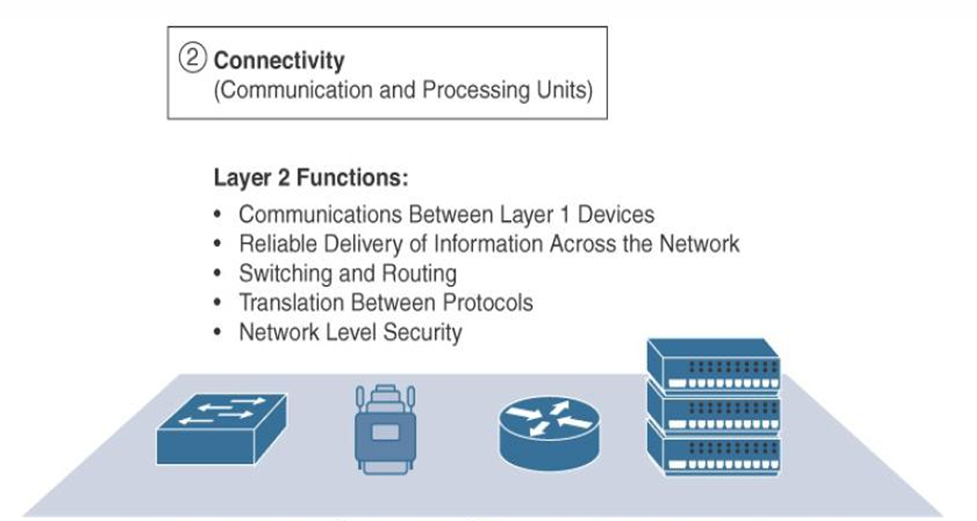
Comparing IoT Architectures
Fig: IoT Reference Model Connectivity Layer Functions

Slide 64
Comparing IoT Architectures

Slide 65
Comparing IoT Architectures
Layer 3: Edge Computing
Edge computing is often referred to as the “fog” layer
At this layer, the emphasis is on data reduction and converting network data flows into information that is ready for storage and processing by higher layers.
One of the basic principles of this reference model is that information processing is initiated as early and as close to the edge of the network as possible

Slide 66
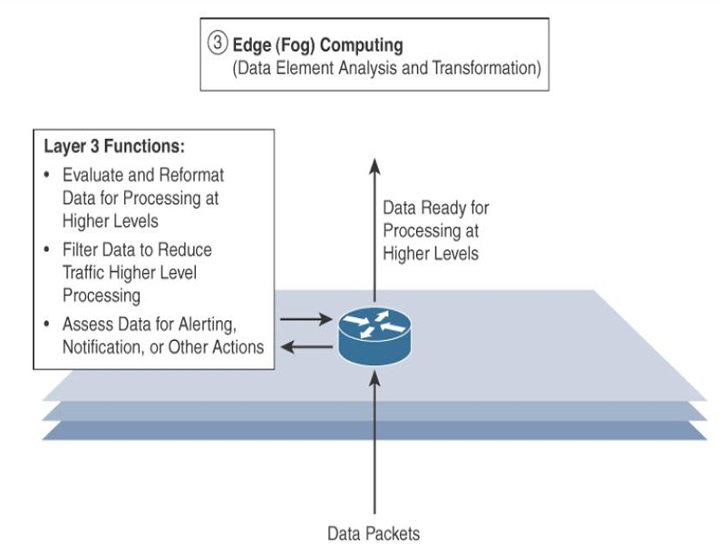
Comparing IoT Architectures
Fig: IoT Reference Model Layer 3 Functions

Slide 67
Comparing IoT Architectures

Slide 68
Comparing IoT Architectures
Upper Layers: Layers 4–7
The upper layers deal with handling and processing the IoT data generated by the bottom layer.

Slide 69
Comparing IoT Architectures
IoT Reference Model Layer | Functions
Layer 4 : Data Accumulation Layer | Captures data and stores it so it usable by applications when necessary. Converts event-based data to query based processing.
Layer 5: Data Abstraction Layer | Reconciles multiple data formats and ensures consistent semantics from various sources. Confirms that the data set is complete and consolidates data into one place or multiple data stores using visualization.
Layer 6: Applications Layer | Interprets data using software applications. Applications may monitor, control and provide reports based on the analysis of the data.
Layer 7: Collaboration and processes layer | Consumes and shares the application information. Collaboration on and communicating IoT information often requires multiple steps and it is what makes IoT useful. This layer can change business processes and delivers benefits of IoT

Slide 70
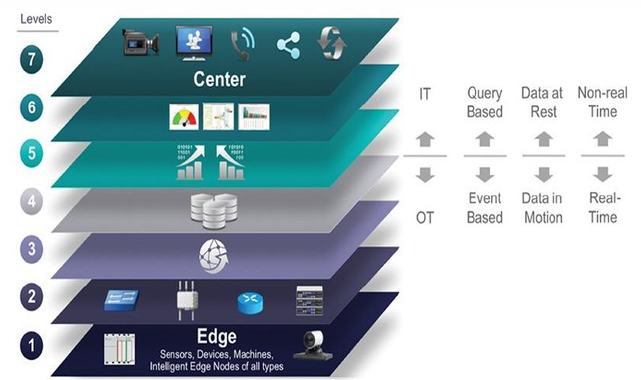
Comparing IoT Architectures
IT and OT Responsibilities in the IoT Reference Model
Fig: IoT Reference Model Separation of IT and OT

Slide 71
Comparing IoT Architectures
IT and OT Responsibilities in the IoT Reference Model
The bottom of the stack is generally in the domain of OT.
For an industry like oil and gas, this includes sensors and devices connected to pipelines, oil rigs, refinery machinery, and so on.
The top of the stack is in the IT area and includes things like the servers, databases, and applications, all of which run on a part of the network controlled by IT.

Slide 72
Comparing IoT Architectures
IT and OT Responsibilities in the IoT Reference Model
At the bottom, in the OT layers, the devices generate real-time data at their own rate
Data has to be buffered or stored at certain points within the IoT stack.
Layering data management in this way throughout the stack helps the top four layers handle data at their own speed.

Slide 73
Comparing IoT Architectures
IT and OT Responsibilities in the IoT Reference Model
The real-time “data in motion” close to the edge has to be organized and stored so that it becomes “data at rest” for the applications in the IT tiers.
The IT and OT organizations need to work together for overall data management.

Slide 74
Comparing IoT Architectures
ADDITIONAL IOT REFERENCE MODELS
Purdue model for control Hierarchy
Industrial Internet Reference Architecture(IIRA) by Industrial Internet Consortium(IIC)
Internet of Things-Architecture(IoT-A)

Slide 75
A Simplified IoT Architecture
we can describe an IoT framework that highlights the fundamental building blocks that are common to most IoT systems and which is intended to help you in designing an IoT network.
This framework is presented as two parallel stacks:
The IoT Data Management and Compute Stack
The Core IoT Functional Stack

Slide 76
A Simplified IoT Architecture
The Core IoT Functional Stack
IoT Data Management and Compute Stack
Applications
Cloud
Security
Communication Networks
Fog
Things: Sensors and Actuators
Edge

Slide 77
A Simplified IoT Architecture
The Core IoT Functional Stack
IoT Data Management and Compute Stack
Vertical Specific Apps (SADA, MDMs, etc)
Applications
Cloud
Analytics
Security
IoT Network Mgmt
Communication Networks
Fog
Network Transport Layer
Gateways and backhaul Network
Things: Sensors and Actuators
Edge
Access Network

Slide 78
The Core IoT Functional Stack
IoT networks are built around the concept of “things,” or smart objects performing functions and delivering new connected services.
These objects are “smart” because they use a combination of contextual information and configured goals to perform actions
“thing” interacts with an external system to report information that the smart object collects, to exchange with other objects, or to interact with a management platform.

Slide 79
The Core IoT Functional Stack
From an architectural standpoint, several components have to work together for an IoT network to be operational
“Things” layer
Communication Layer
Access Network Sublayer
Gateways and backhaul network sublayer
Network transport sublayer
IoT network management sublayer
Application and analytical Layer

Slide 80
Layer 1: Things: Sensors and Actuators Layer
Most IoT networks start from the object, or “thing,” that needs to be connected.
From an architectural standpoint, the variety of smart object types, shapes, and needs drive the variety of IoT protocols and architectures.

Slide 81
Layer 1: Things: Sensors and Actuators Layer
1. Battery-powered or power-connected
2. Mobile or static
3. Low or high reporting frequency
4. Simple or rich data
5. Report range
6. Object density per cell

Slide 82
Layer 1: Things: Sensors and Actuators Layer
1. Battery-powered or power-connected
This classification is based on whether the object carries its own energy supply or receives continuous power from an external power source.
Battery-powered things can be moved more easily than line powered objects.
Batteries limit the lifetime and amount of energy that the object is allowed to consume, thus driving transmission range and frequency

Slide 83
Layer 1: Things: Sensors and Actuators Layer
2. Mobile or static
This classification is based on whether the “thing” should move or always stay at the same location.
A sensor may be mobile because it is moved from one object to another or because it is attached to a moving object
The frequency of the movement may also vary, from occasional to permanent.

Slide 84
Layer 1: Things: Sensors and Actuators Layer
3. Low or high reporting frequency
This classification is based on how often the object should report monitored parameters.
A rust sensor may report values once a month.
A motion sensor may report acceleration several hundred times per second.
Higher frequencies drive higher energy consumption

Slide 85
Layer 1: Things: Sensors and Actuators Layer
4. Simple or rich data
This classification is based on the quantity of data exchanged at each report cycle.
A humidity sensor in a field may report a simple daily index and while an engine
Sensor may report hundreds of parameters, from temperature to pressure, gas velocity etc.
Richer data typically drives higher power consumption.

Slide 86
Layer 1: Things: Sensors and Actuators Layer
5. Report range
This classification is based on the distance at which the gateway is located.
6. Object density per cell
This classification is based on the number of smart objects over a given area, connected to the same gateway

Slide 87
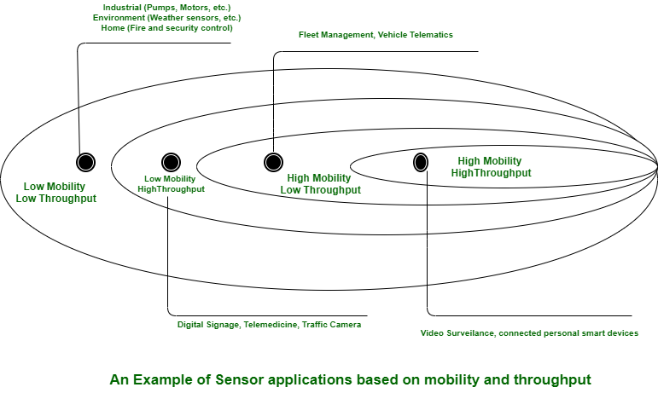
Layer 1: Things: Sensors and Actuators Layer

Slide 88
Layer 2: Communication Network Layer
When smart objects are not self contained, they need to communicate with an external system. In many cases, this communication uses a wireless technology. This layer has four sublayers:
1. Access Network Sublayer
2. Gateways and backhaul network sublayer
3. Network transport sublayer
4. IoT network management sublayer

Slide 89
Layer 2: Communication Network Layer
1. Access Network Sublayer
There is a direct relationship between the IoT network technology we choose and the type of connectivity topology this technology allows
Each technology was designed with a certain number of use cases in mind
what to connect, where to connect, how much data to transport at what interval and over what distance.

Slide 90
Layer 2: Communication Network Layer
1. Access Network Sublayer
As IoT continues to grow exponentially, we will encounter a wide variety of applications and special use cases.
For each of them, an access technology will be required. IoT sometimes reuses existing access technologies whose characteristics match more or less closely the IoT use case requirements.
One key parameter determining the choice of access technology is the range between the smart object and the information collector.

Slide 91
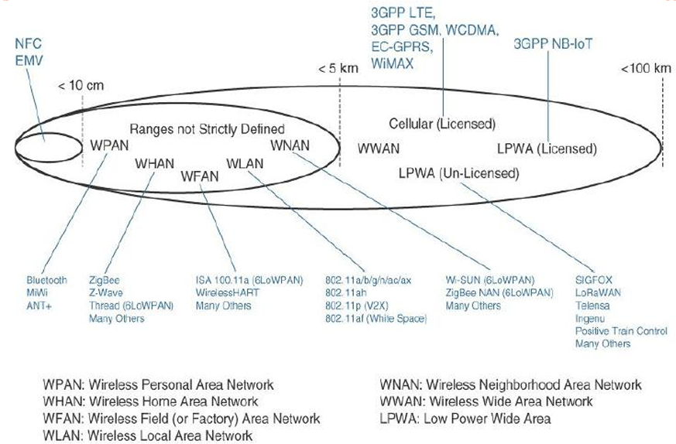
Figure 2.9 : Access Technologies and Distances

Slide 92
Layer 2: Communication Network Layer
1. Access Network Sublayer
Figure 2.9 lists some access technologies we may encounter in the IoT world and the expected transmission distances.
Range estimates are grouped by category names that illustrate the environment or the vertical where data collection over that range is expected.

Slide 93
Layer 2: Communication Network Layer
1. Access Network Sublayer
Common groups are as follows:
PAN (personal area network): Scale of a few meters. This is the personal space around a person. A common wireless technology for this scale is Bluetooth.
HAN (home area network): Scale of a few tens of meters. At this scale, common wireless technologies for IoT include ZigBee and Bluetooth Low Energy

Slide 94
Layer 2: Communication Network Layer
1. Access Network Sublayer
Common groups are as follows:
NAN (neighbourhood area network): Scale of a few hundreds of meters. The term NAN is often used to refer to a group of house units from which data is collected.
FAN (field area network): Scale of several tens of meters to several hundred meters. FAN typically refers to an outdoor area larger than a single group of house units.

Slide 95
Layer 2: Communication Network Layer
1. Access Network Sublayer
Common groups are as follows:
LAN (local area network): Scale of up to 100 m. This term is very common in networking, and it is therefore also commonly used in the IoT space when standard networking technologies (such as Ethernet or IEEE 802.11) are used.

Slide 96
Layer 2: Communication Network Layer
1. Access Network Sublayer
Figure 2.10 demonstrates four technologies representing WHAN to WLAN ranges and compares the throughput and range that can be achieved in each case.

Slide 97
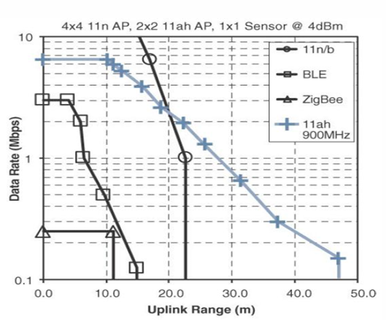
Figure 2.10 : Range Versus Throughput for Four WHAN to WLAN Technologies

Slide 98
Layer 2: Communication Network Layer
1. Access Network Sublayer
Figure 2.11 combines cost, range, power consumption, and typical available bandwidth for common IoT access technologies.

Slide 99
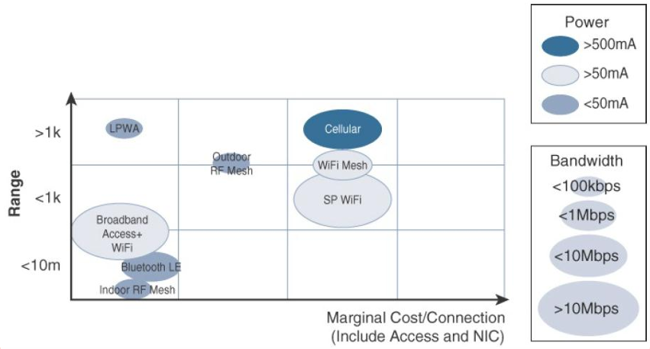
Figure 2.11 : Comparison Between Common Last-Mile Technologies in Terms of Range Versus Cost, Power, and Bandwidth

Slide 100
Layer 2: Communication Network Layer
1. Access Network Sublayer
Communication topologies:
Some technologies offer flexible connectivity structure to extend communication possibilities
1. Point-to-point topologies:
These topologies allow one point to communicate with another point.
several technologies are referred to as “point-to-point” when each object establishes an individual session with the gateway.

Slide 101
Layer 2: Communication Network Layer
1. Access Network Sublayer
2. Point-to-multipoint topologies:
These topologies allow one point to communicate with more than one other point.
Most IoT technologies where one or more than one gateways communicate with multiple smart objects are in this category

Slide 102
Layer 2: Communication Network Layer
1. Access Network Sublayer
2. Point-to-multipoint topologies:
To form a network, a device needs to connect with another device.
When both devices fully implement the protocol stack functions,
they can form a peer-to peer network.

Slide 103
Layer 2: Communication Network Layer
1. Access Network Sublayer
2. Point-to-multipoint topologies:
The sensor which can implement a subset of protocol functions to perform just a specialized part (communication with the coordinator). Such a device is called a reduced-function device (RFD).
An RFD cannot be a coordinator. An RFD also cannot implement direct communications to another RFD.

Slide 104
Layer 2: Communication Network Layer
1. Access Network Sublayer
2.Point-to-multipoint topologies:
The coordinator that implements the full network functions is called, by contrast, a full-function device (FFD).
An FFD can communicate directly with another FFD or with more than one FFD, forming multiple peer-to-peer connections.

Slide 105
Layer 2: Communication Network Layer
1. Access Network Sublayer
2.Point-to-multipoint topologies:
Topologies where each FFD has a unique path to another FFD are called cluster tree topologies. FFDs in the cluster tree may have RFDs, resulting in a cluster star topology.
Other point-to-multipoint technologies allow a node to have more than one path to another node, forming a mesh topology.
Figure 2.12 illustrates these topologies

Slide 106
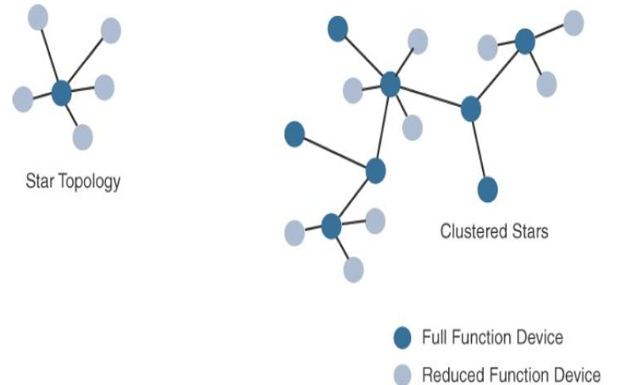
Figure 2.12 :Star and Clustered Star Topologies

Slide 107
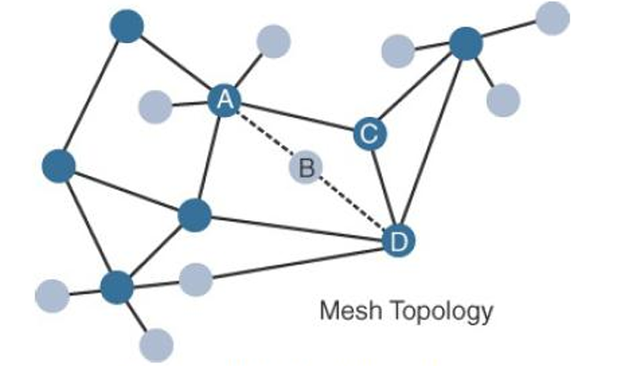
Figure 2.12 :Mesh Topology

Slide 108
Layer 2: Communication Network Layer
2. Gateway and Backhaul Sublayer
Data collected from a smart object may need to be forwarded to a central station where data is processed.
As this station is often in a different location from the smart object, data directly received from the sensor through an access technology needs to be forwarded to another medium (the backhaul) and transported to the central station.
Ex: A dedicated short-range communication (DSRC) allows vehicle-to-vehicle and vehicle-to-infrastructure communication.

Slide 109
Layer 2: Communication Network Layer
2. Gateway and Backhaul Sublayer
The gateway is in charge of this inter-medium communication.
In most cases, the smart objects are static or mobile within a limited area.
The gateway is often static. However, some IoT technologies do not apply this model.

Slide 110
Layer 2: Communication Network Layer
2. Gateway and Backhaul Sublayer
When the smart object’s operation is controlled from a local site, and when the environment is stable (for example, factory or oil and gas field), Ethernet can be used as a backhaul.
WiMAX (802.16) is an example of a longer-range technology. WiMAX can achieve ranges of up to 50 kilometers with rates of up to 70 Mbps.

Slide 111
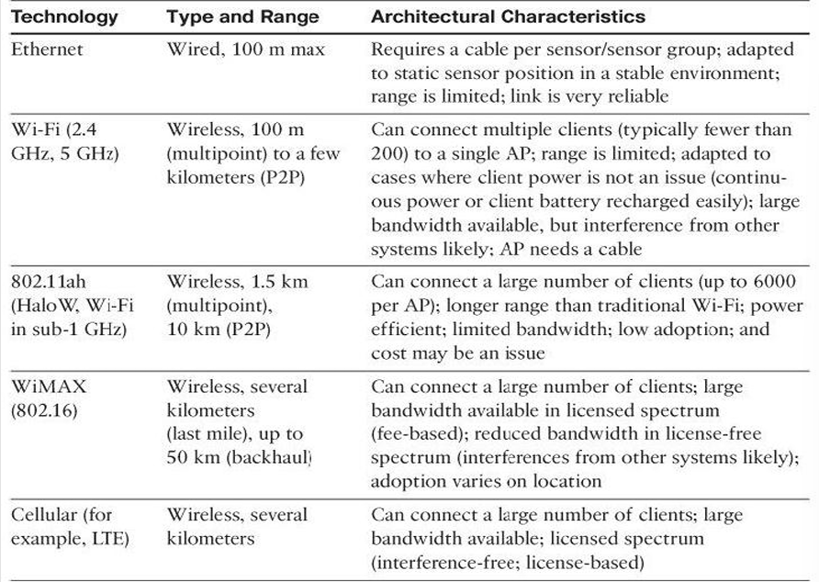
Table 2-4 :Architectural Considerations for WiMax and Cellular Technologies

Slide 112
Layer 2: Communication Network Layer
3. Network Transport Sublayer
We know that a hierarchical communication architecture in which a series of smart objects report to a gateway that conveys the reported data over another medium and up to a central station.
However, practical implementations are often flexible, with multiple transversal communication paths

Slide 113
Layer 2: Communication Network Layer
3. Network Transport Sublayer
Communication Structure involve
Peer to peer
Point-to-point
Point-to-multipoint
unicast and multicast communications (software update to one or multiple systems)

Slide 114
Layer 2: Communication Network Layer
3. Network Transport Sublayer
communication occurs over multiple media
For ex: power lines inside our house or a short range wireless system like indoor Wi-Fi and/or ZigBee
A longer-range wireless system to the gateway, and yet another wireless or wired medium for backhaul transmission.
To allow for such communication structure, a network protocol with specific characteristics needs to be implemented.

Slide 115
Layer 2: Communication Network Layer
The protocol needs to be open and standard-based to accommodate multiple industries and multiple media.
Scalability (to accommodate thousands or millions of sensors in a single network) and security are also common requirements.
IP is a protocol that matches all these requirements.
The flexibility of IP allows this protocol to be embedded in objects of very different natures, exchanging information over very different media, including low-power, lossy, and low-bandwidth networks.

Slide 116
Layer 2: Communication Network Layer
Finally, the transport layer protocols built above IP (UDP and TCP) can easily be leveraged to decide whether the network should control the data packet delivery (with TCP) or whether the control task should be left to the application (UDP).

Slide 117
Layer 2: Communication Network Layer
4. IoT Network Management Sublayer
IP, TCP, and UDP bring connectivity to IoT networks.
Upper-layer protocols need to take care of data transmission between the smart objects and other systems.
Multiple protocols have been created to solve IoT data communication problems.
Some networks depends on a push model and some other networks depends on a pull model

Slide 118
Layer 2: Communication Network Layer
4. IoT Network Management Sublayer
some IoT implementers have suggested HTTP which has a client and server component.
But HTTP is something of a fat protocol and was not designed to operate in constrained environments with low memory, low power, low bandwidth, and a high rate of packet failure.
Despite these limitations, other web derived protocols have been suggested for the IoT space.

Slide 119
Layer 2: Communication Network Layer
4. IoT Network Management Sublayer
One example is WebSocket.
WebSocket is part of the HTML5 specification, and provides a simple bidirectional connection over a single connection
WebSocket is often combined with other protocols, such as MQTT to handle the IoT-specific part of the communication.
With the same logic of reusing well-known methods, Extensible Messaging and Presence Protocol (XMPP) was created.

Slide 120
Layer 2: Communication Network Layer
4. IoT Network Management Sublayer
XMPP is based on instant messaging and presence.
It allows the exchange of data between two or more systems and supports presence and contact list maintenance
To respond to the limits of web-based protocols, another protocol was created by the IETF Constrained Restful Environments (CoRE) working group: Constrained Application Protocol (CoAP).

Slide 121
Layer 2: Communication Network Layer
4. IoT Network Management Sublayer
CoAP uses some methods similar to those of HTTP (such as Get, Post, Put, and Delete) but implements a shorter list, thus limiting the size of the header.
CoAP also runs on UDP (whereas HTTP typically uses TCP). CoAP also adds a feature that is lacking in HTTP and very useful for IoT.
Another common IoT protocol utilized in these middle to upper layers is Message Queue Telemetry Transport (MQTT).

Slide 122
Layer 2: Communication Network Layer
4. IoT Network Management Sublayer
MQTT uses a broker-based architecture.
The sensor can be set to be an MQTT publisher (publishes a piece of information).
The application that needs to receive the information can be set as the MQTT subscriber.
Any intermediary system can be set as a broker to relay the information between the publisher and the subscriber(s).
MQTT runs over TCP. A consequence of the reliance on TCP is that an MQTT client typically holds a connection open to the broker at all times.

Slide 123
Layer 3: Applications And Analytics Layer
Once connected to a network, our smart objects exchange information with other systems.
As soon as our IoT network spans more than a few sensors, the power of the Internet of Things appears in the applications that make use of the information exchanged with the smart objects
From an architectural standpoint, basic classification can be as follows:
Analytics Versus Control Applications
Data Versus Network Analytics

Slide 124
Layer 3: Applications And Analytics Layer
Analytics Versus Control Applications
Multiple applications can help increase the efficiency of an IoT network.
Each application collects data and provides a range of functions based on analysing the collected data.
Analytics Application
Control Application

Slide 125
Layer 3: Applications And Analytics Layer
Analytics Application:
This type of application collects data from multiple smart objects, processes the collected data, and displays information resulting from the data that was processed.
The display can be about any aspect of the IoT network, from historical reports, statistics, or trends to individual system states.
Control Application:
This type of application controls the behaviour of the smart object or the behaviour of an object related to the smart object.
For ex : a pressure sensor may be connected to a pump

Slide 126
Layer 3: Applications And Analytics Layer
An example of control system architecture is SCADA.
SCADA was developed as a universal method to access remote systems and send instructions.
One example where SCADA is widely used is in the control and monitoring of remote terminal units (RTUs) on the electrical distribution grid.

Slide 127
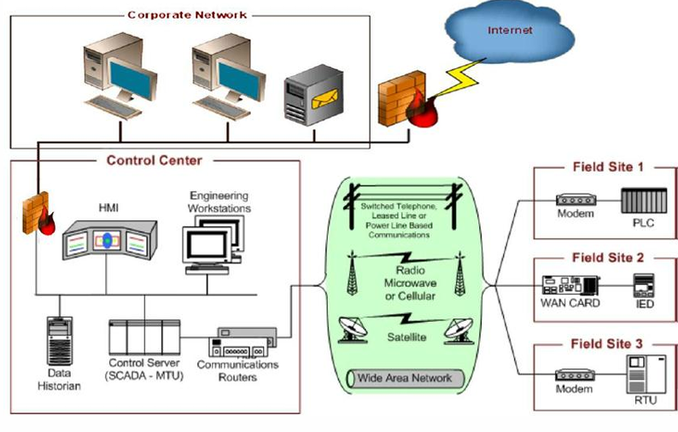
Layer 3: Applications And Analytics Layer
SUPERVISORY CONTROL AND DATA ACQUISITION (SCADA)

Slide 128
Layer 3: Applications And Analytics Layer
Data Versus Network Analytics
Data analytics:
This type of analytics processes the data collected by smart objects and combines it to provide an intelligent view related to the IoT system.
Network analytics:
Most IoT systems are built around smart objects connected to the network.
A loss or degradation in connectivity is likely to affect the efficiency of the system. Such a loss can have dramatic effects.

Slide 129
IoT Data Management and Compute Stack
The massive scale of IoT networks is fundamentally driving new architectures. As per the projections by Cisco nearly 50 billion devices will be connected to the IoT networks by the year 2020.
In fact, the data generated by IoT sensors is one of the single biggest challenges in building an IoT system.
In the case of modern IT networks, the data sourced by a computer or server is typically generated by the client/server communications model, and it serves the needs of the application.
In sensor networks, the vast majority of data generated is unstructured and of very little use on its own.

Slide 130
IoT Data Management and Compute Stack
In most cases, the processing location is outside the smart object. A natural location for this processing activity is the cloud.
Smart objects need to connect to the cloud, and data processing is centralized.
One advantage of this model is simplicity. Objects just need to connect to a central cloud application.
This model also has some limitations.
The data volume increases with more number of smart objects being connected to the network which in turn creates a new requirements.

Slide 131
IoT Data Management and Compute Stack
These new requirements include the following
1. Minimizing latency
2. Conserving network bandwidth
3. Increasing local efficiency

Slide 132
IoT Data Management and Compute Stack
In most cases, the processing location is outside the smart object. A Data management in traditional IT systems is very simple.
The endpoints (laptops, printers, IP phones, and so on) communicate over an IP core network to servers in the data center or cloud.
Data is generally stored in the data center, and the physical links from access to core are typically high bandwidth, meaning access to IT data is quick.

Slide 133
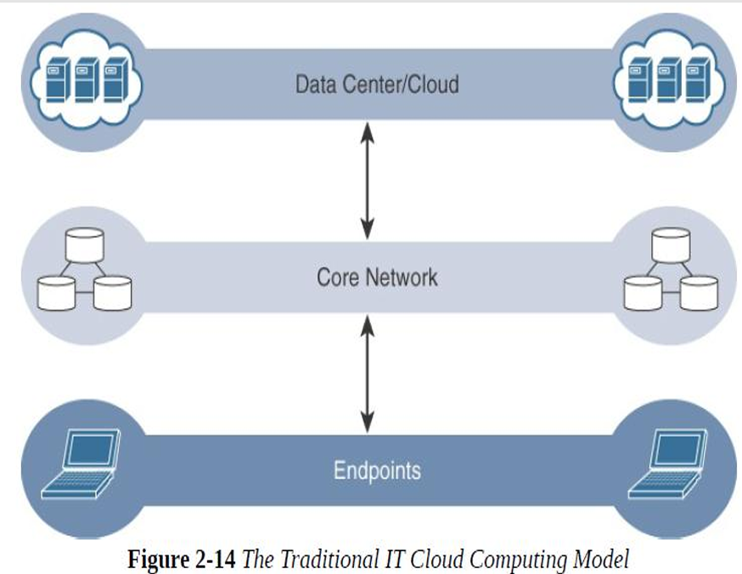

Slide 134
IoT Data Management and Compute Stack
IoT systems function differently. Several data-related problems need to be addressed:
Bandwidth in last-mile IoT networks is very limited.
Latency can be very high.
Network backhaul from the gateway can be unreliable and often depends on 3G/LTE or even satellite links
The volume of data transmitted over the backhaul can be high, and much of the data may not really be that interesting(such as simple polling messages).
Big data is getting bigger. The concept of storing and analyzing all sensor data in the cloud is impractical.

Slide 135
IoT Data Management and Compute Stack
Fog Computing
The solution to the challenges encountered in data management is to distribute data management throughout the IoT system, as close to the edge of the IP network as possible.
The best-known embodiment of edge services in IoT is fog computing.
Any device with computing, storage, and network connectivity can be a fog node.
Examples include industrial controllers, switches, routers, embedded servers, and IoT gateways

Slide 136
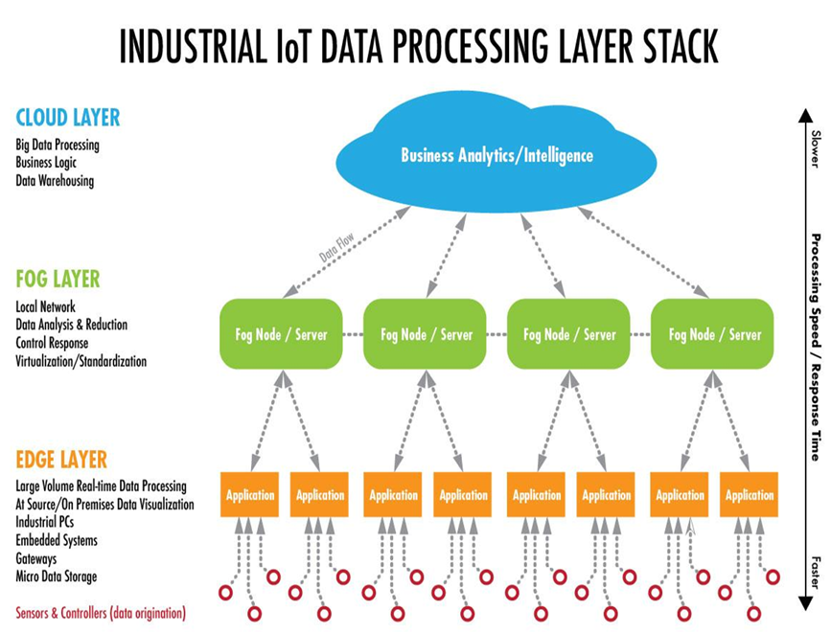

Slide 137
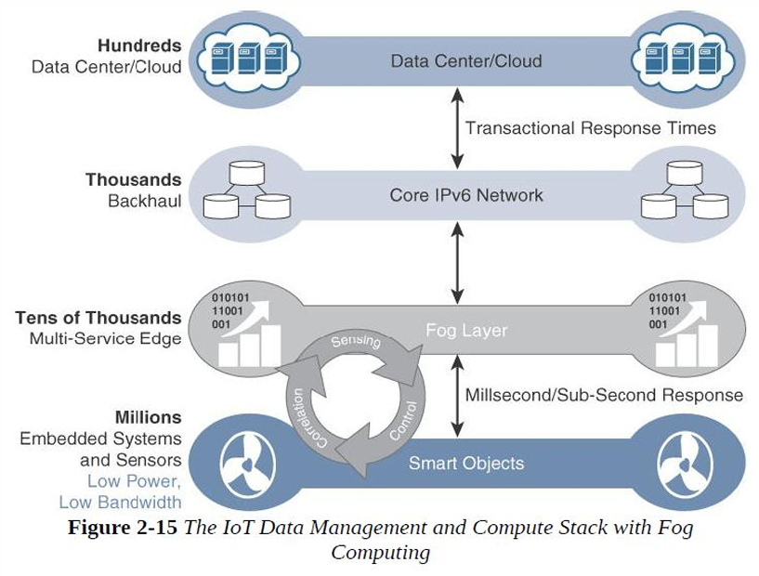

Slide 138
IoT Data Management and Compute Stack
The characteristic of fog computing are as follows:
Contextual location awareness and low latency
Geographic distribution
Deployment near IoT endpoints
Wireless communication between the fog and the IoT endpoint
Use for real-time interactions

Slide 139
IoT Data Management and Compute Stack
Contextual location awareness and low latency:
The fog node sits as close to the IoT endpoint as possible to deliver distributed computing.
Geographic distribution:
In sharp contrast to the more centralized cloud, the services and applications targeted by the fog nodes demand widely distributed deployments.
Deployment near IoT endpoints:
Fog nodes are typically deployed in the presence of a large number of IoT endpoints.

Slide 140
IoT Data Management and Compute Stack
Wireless communication between the fog and the IoT endpoint:
Although it is possible to connect wired nodes, the advantages of fog are greatest when dealing with a large number of endpoints, and wireless access is the easiest way to achieve such scale.
Use for real-time interactions:
Important fog applications involve real-time interactions rather than batch processing.
Pre-processing of data in the fog nodes allows upper-layer applications to perform batch processing on a subset of the data.

Slide 141
IoT Data Management and Compute Stack
EDGE COMPUTING
Edge computing as “a part a distributed computing topology in which information of processing is located close to the edge – where things and people produce or consume that information.”
Edge compute–capable meters are able to communicate with each other to share information on small subsets.
Edge computing is also sometimes called “mist” computing.

Slide 142
IoT Data Management and Compute Stack
THE HIERARCHY OF EDGE, FOG, AND CLOUD
This model suggests a hierarchical organization of network, compute, and data storage resources.
At each stage, data is collected, analyzed, and responded to when necessary, according to the capabilities of the resources at each layer.
advantage of hierarchy
response to events from resources close to the end device is fast and can result in immediate benefits
resources available in the cloud when necessary

Slide 143
IoT Data Management and Compute Stack
THE HIERARCHY OF EDGE, FOG, AND CLOUD
Figure 2.16 illustrates the hierarchical nature of edge, fog, and cloud computing across an IoT system.
From an architectural standpoint, fog nodes closest to the network edge receive the data from IoT devices
The fog IoT application then directs different types of data to the optimal place for analysis:

Slide 144
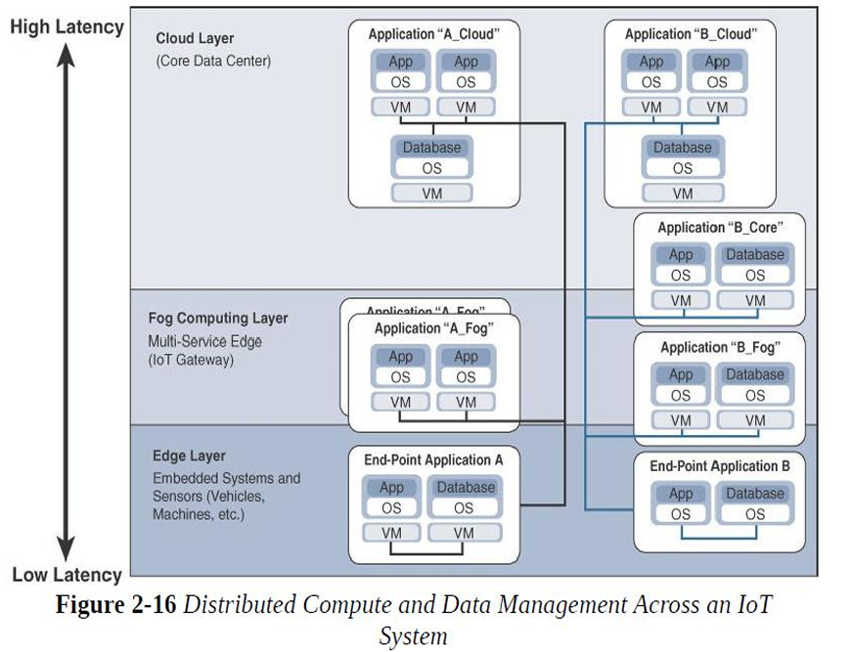

Slide 145
IoT Data Management and Compute Stack
The fog IoT application directs different types of data for analysis:
The most time-sensitive data is analyzed on the edge or fog node closest to the things generating the data.
Data that can wait seconds or minutes for action is passed along to an aggregation node for analysis and action.
Data that is less time sensitive is sent to the cloud for historical analysis, big data analytics, and long-term storage.

